Slide 1
Sprint 4
PerlSquad

Slide 2
Communication with Client
Deployed the game to one of our client’s classroom, where 28 students played it
In contact with the clients regarding final presentation and timeline for the end of the year
Provided us with UI suggestions and ways we can improve learning outcomes for students
Better feedback, more instructions, etc...

Slide 3
Improvements this Sprint
UI Improvements
“OK” buttons can now be clicked without actually being over the text
Informative blurbs on the info screen are now easier to read
Scrolling Game Improvements
Smoother animations
Animals have drop shadows to be easier to see
More feedback/instruction - especially on easy difficulty
Animals speed up over time to provide more challenge (may need adjusting)
Animals now appear on postgame screen with their info text

Slide 4
Improvements this Sprint (Cont.)
Preload ALL the things
X/Y Coordinates, Scale, and Text Descriptions all now completely preloaded
Scrapped/Replaced old customization screen
No more Add Button
Edit now opens mock Info Screen, where you can/will be able to:
Add new images/ Delete old images
Edit Text
Scale Images
Move Images
Switch between Biomes
etc.

Slide 5
Plans for the future
Finish the customization aspect of the game
Another round of deployment and feedback, at least from the clients themselves
Further UI improvements
More initial instructions in minigame
Implement the feedback

Slide 6
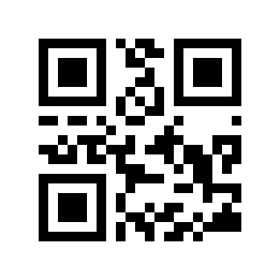
QR Code

Slide 7
DEMO TIME...

